Slide 1
Simulating Galaxy Outflows in the Circumgalactic Medium
Gabriela Huckabee

Slide 2
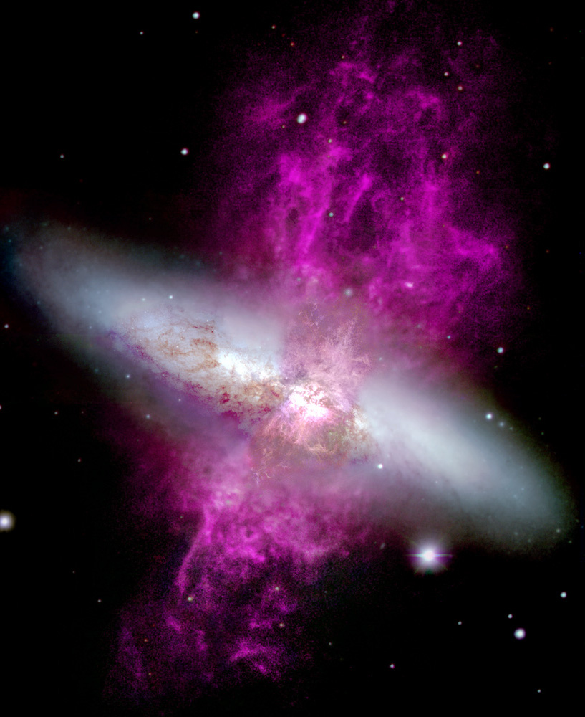
Background
Galaxy outflows are indicators of galactic activity
Outflows influence ion abundances in the circumgalactic medium
Lots of OVI and CIV but notable lack of NV
Previous simulations have analyzed ion abundances as a post-processing step
Hɑ outflows in M82 taken my WIYN

Slide 3
FLASH Simulation
FLASH simulation code from the University of Chicago
Hot gas (outflow) flowing over dense, cold gas (circumgalactic medium)
Vary velocity, temperature, and density
Account for radiative cooling, thermal conduction, and non-equilibrium chemistry
Python package yt used to view ion projections
Python package Trident will be used to generate spectra

Slide 4
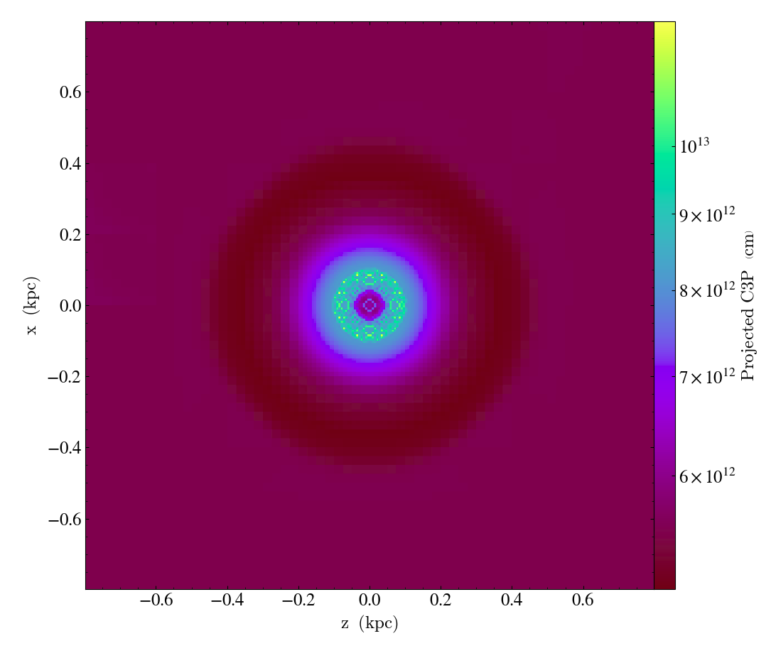
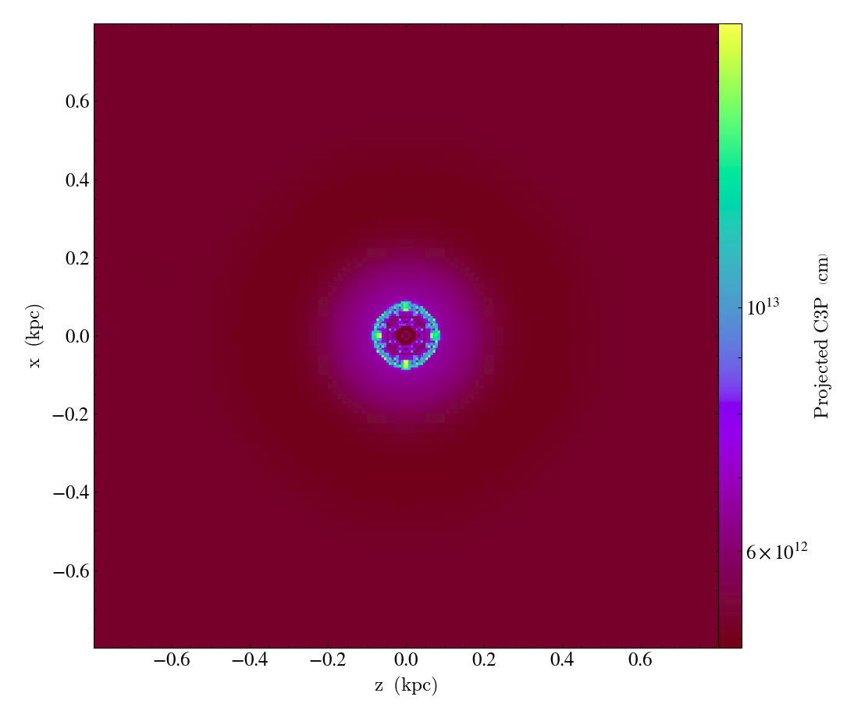
CIV Projection
Checkpoint 0003
Checkpoint 0007

Slide 5
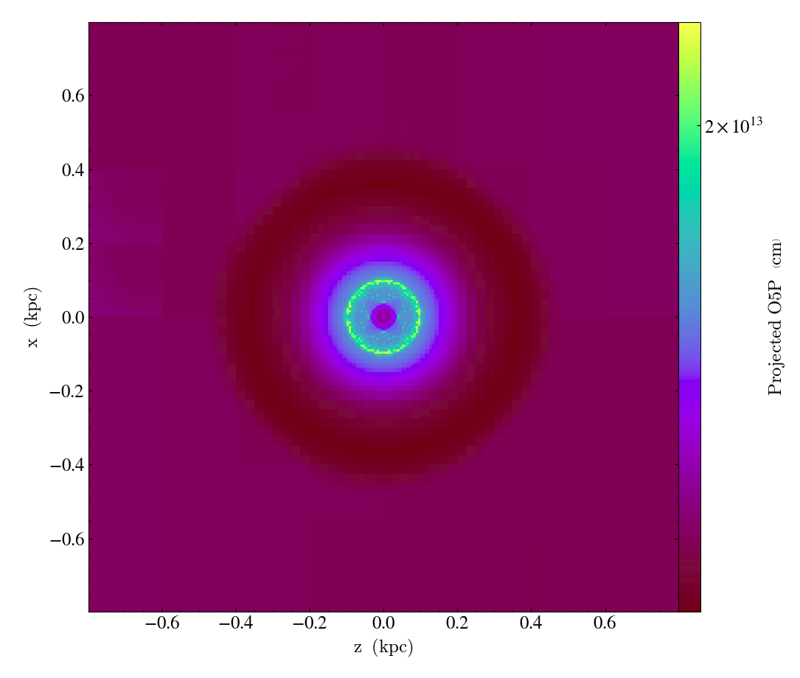
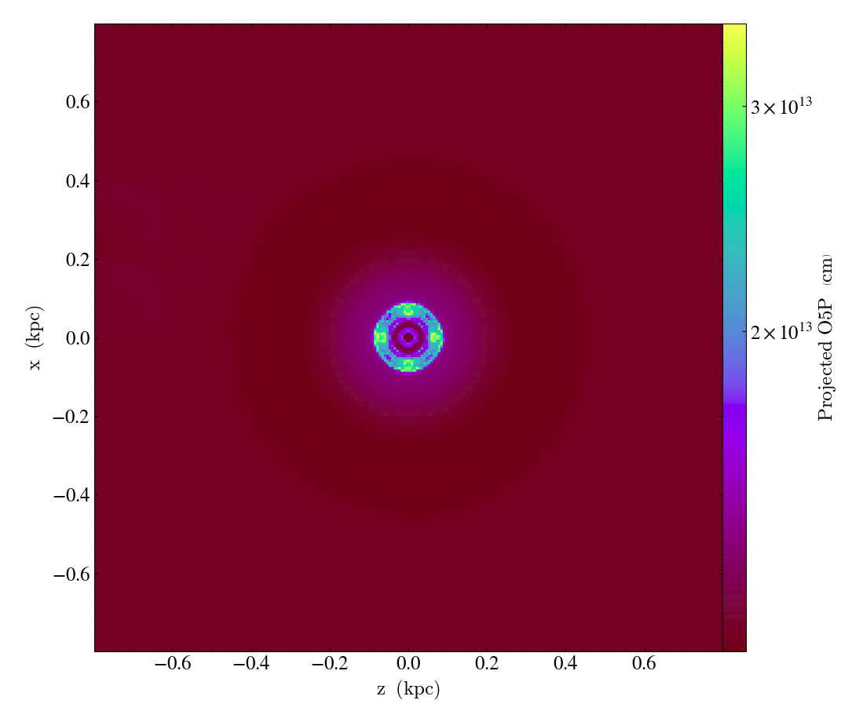
OVI Projection
Checkpoint 0003
Checkpoint 0007

Slide 6
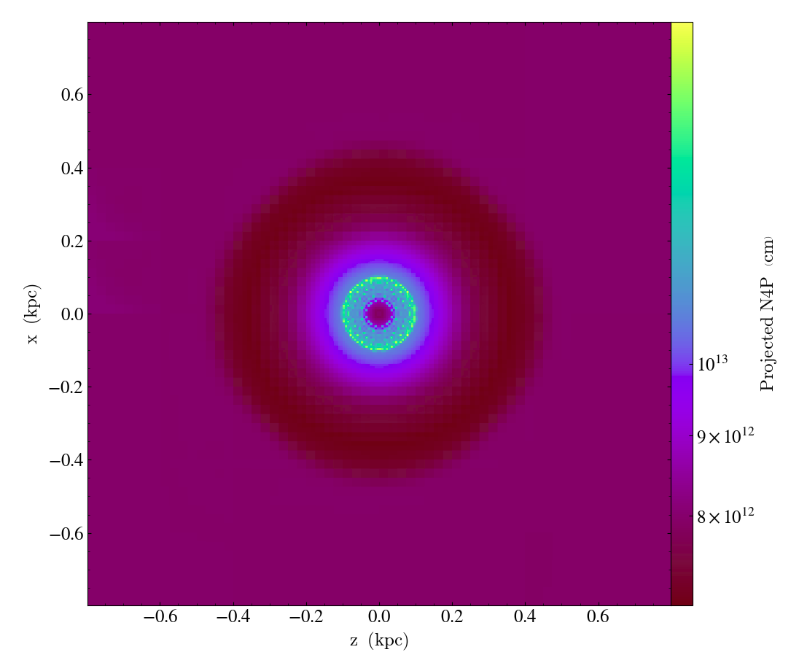
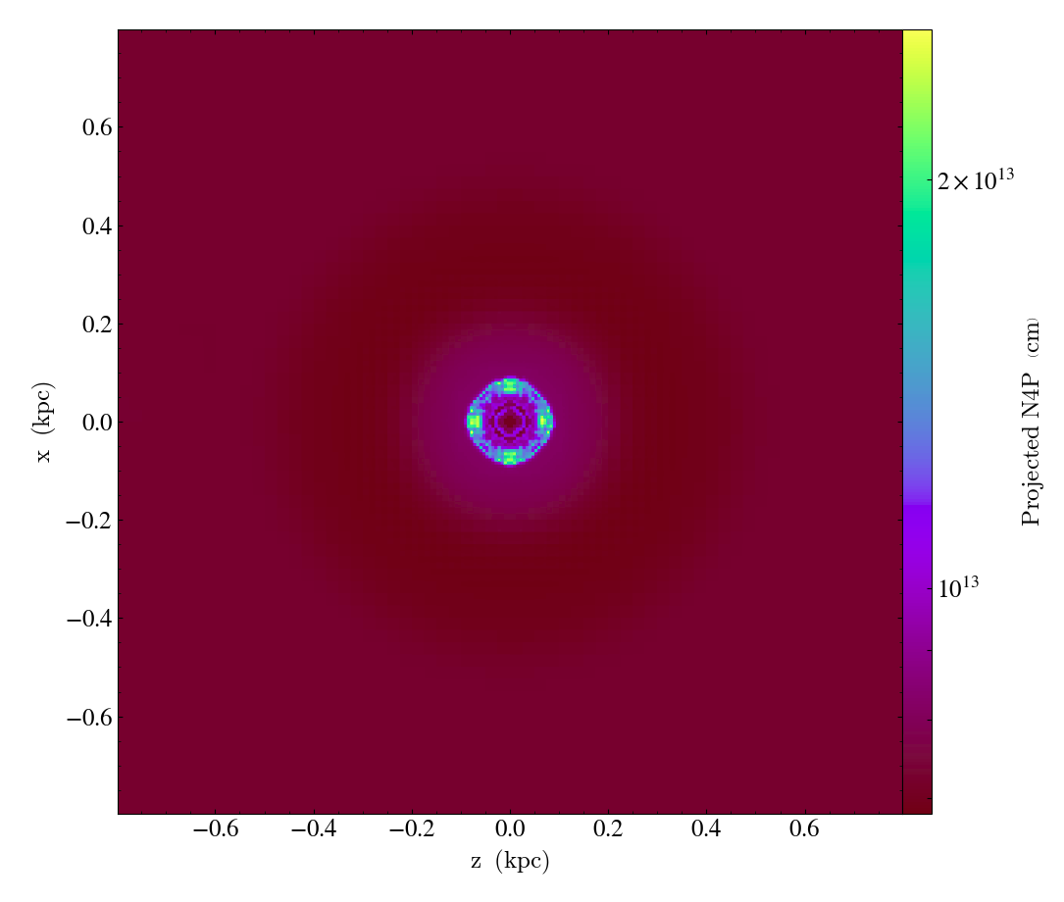
NV Projection
Checkpoint 0003
Checkpoint 0007

Slide 7
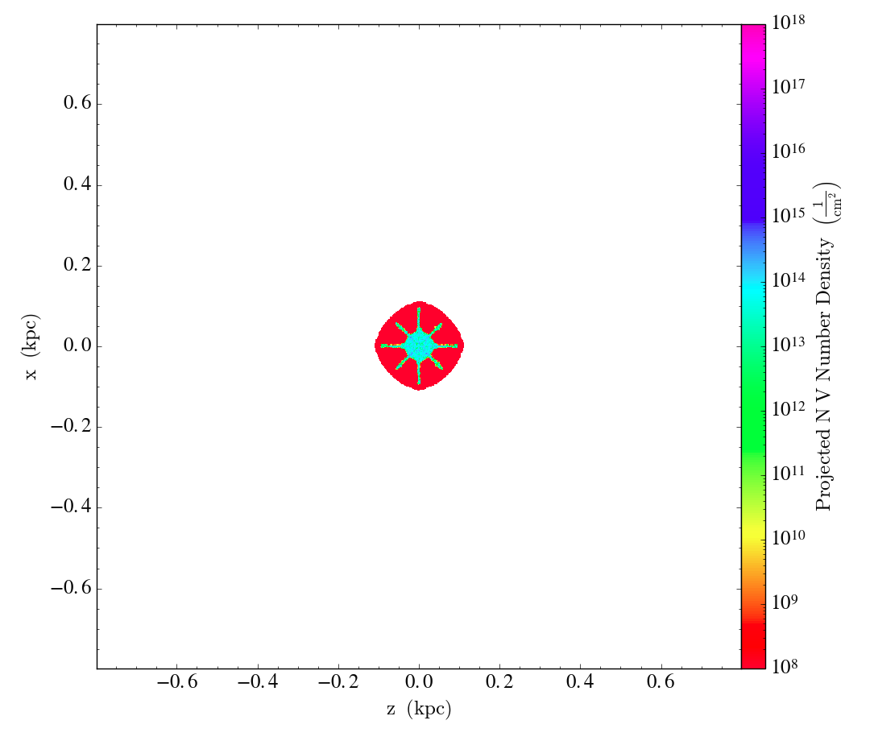
Comparison with Conduction Runs
Notes:
NV Chk 0070

Slide 8
Discussion and Conclusion
Non-equilibrium chemistry does cause some clear variations from equilibrium chemistry runs
Still more NV in simulations than in observations
OVI and CIV diffuse much more than NV
OVI, CIV, and NV all concentrate at the edge of the cloud at late times
Grid refinement issue - adaptive mesh refinement causing problems with other ion species
Grid refinement errors will be looked into and fixed before next run

Slide 9
Acknowledgments
Thank you to J’Neil Cottle and Evan Scannapieco for serving as primary mentors on this project and conducting the projects that led to this one
Thank you to Edward Buie II and William Gray for helping set up the non-equilibrium chemistry in this simulation and troubleshoot the chemistry errors
Thank you to the NASA Space Grant Program coordinators for helping to make this project possible

Slide 10
Questions?

